Slide 1
Introduction to Machine Learning
All for One
Choi Minjoo
Notes:
Good evening everyone, I'll start the presentation.
Today, let's talk about how artificial intelligence can train.

Slide 2
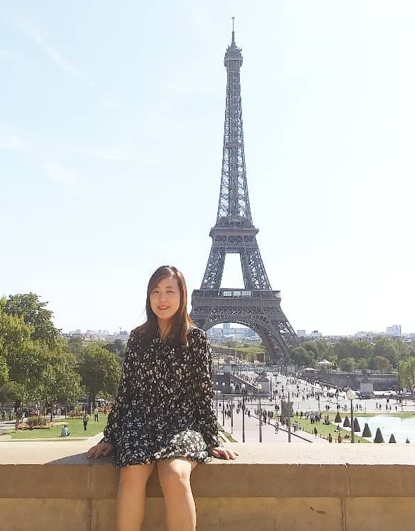
Choi Minjoo (Judy Choi)
Careers
2012 ~ 2019 Malware Analyst
2018 Working Holiday in France
2020 ~ M.S in Kangwon Univ
Intelligence Software Lab
NLP (Machine Translation)
2021 ~ 2022 Bering Lab (NLP Researcher & Engineer)
SNS
https://www.facebook.com/minjoo.choi.562/
https://github.com/Judy-Choi
Notes:
Hello, I’m a team member of the All for One.
My dream is to overcome the language barrier,
so I studied NLP in graduate school to develop machine translation service.
Luckily, from last year I worked as a researcher in startup.
I trained neural machine translation model and built parallel language datasets.
I'm glad to meet you beyond the language barrier.

Slide 3
Contents
Abstract of Deep Learning
Natural Language Processing (NLP)
Machine Translation

Slide 4
Abstract of Deep Learning
Notes:
딥러닝의 발전과 주요 활용분야 (CV, NLP)

Slide 5
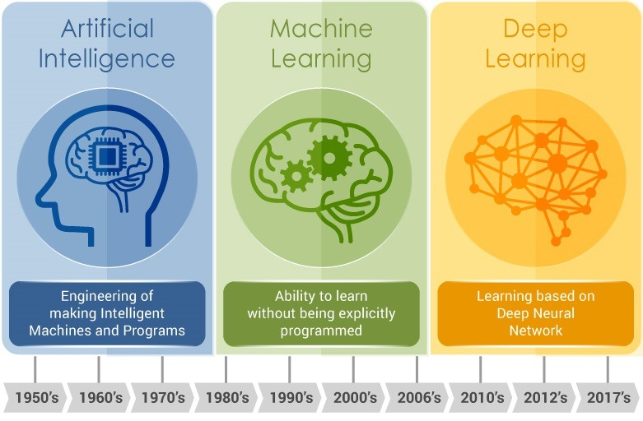
from A.I to Deep Learning...
Notes:
AI On the first day of the AI class, we could found out that AI was the intelligence created by imitating human intelligence. The concept of artificial intelligence first emerged in the 1950s and 2010s, and the development of Deep Learning led to the era of artificial intelligence.
Machine Learning In succession, we have machine Learning, which is one of the ways to implement artificial intelligence that allow machines to learn. It has the ability to learn without being explicitly programmed.
Deep Learning Then came Deep Learning, a step further from Machine Learning. Deep learning is a class of machine learning algorithms that uses multiple layers to progressively extract higher-level features from the raw input. For example, in image processing, lower layers may identify edges, while higher layers may identify the concepts relevant to a human such as digits or letters or faces. From the next chapter, we are going to look at the types and principle of Machine Learning and Deep Learning.

Slide 6

Machine Learning
https://medium.com/intro-to-artificial-intelligence/reinforce-a-policy-gradient-based-reinforcement-learning-algorithm-84bde440c816
Notes:
Arthur Samuel described Machine Learning as: "the field of study that gives computers the ability to learn without being explicitly programmed." And this is old, informal definition. In general, machine learning can be assigned to one of two broad classifications. supervised learning, OR unsupervised learning. And there is also Reinforce Learning.

Slide 7
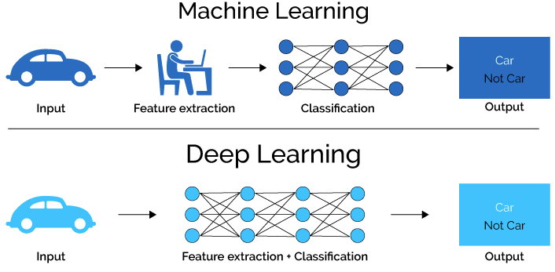
Machine Learning vs Deep Learning
https://lawtomated.com/a-i-technical-machine-vs-deep-learning/
Notes:
We have learned about the definition of machine learning and some models earlier.
Machine learning is simple and useful, but there is a limit to do complex tasks.
So we have ‘Deep learning’, an advanced form of machine learning.
The most difference between machine learning and deep learning is Feature Extraction.
In Machine Learning, human extract features from input. And after extracting features, it is classified by algorithms.
On the other hand, in deep learning, algorithm extracts features from input and classifies.

Slide 8

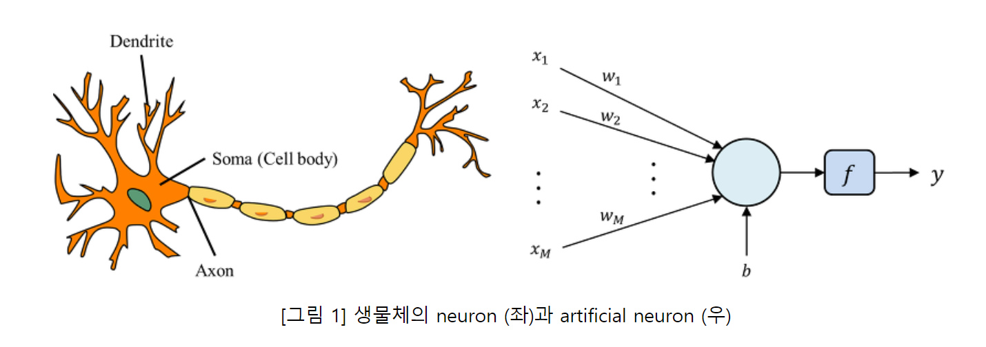
Deep Learning
Neural Network
Artificial neural network mimicking neural networks in the human brain.
Brain : Neuron = A.I : Perceptron
https://smartstuartkim.wordpress.com/2019/01/27/history-of-neural-networks-1-perceptron/
https://gongster.medium.com/how-does-a-neural-network-work-intuitively-in-code-f51f7b2c1e3f
Notes:
The point of Deep Learning is ‘artificial neural network’.
Artificial neural networks mimic neural networks in the human brain.
The picture of the left side is neuron of the human brain. Each neuron inputs their signal and outputs to next neuron.
And the picture of the right side is artificial neuron. This is called perceptron in Computer Science. Like human neurons, they output y by inputting x.
These perceptron configure the Deep Learning Network. So what a neural network is a full of perceptron such as brains made up of neurons that can be learned.

Slide 9
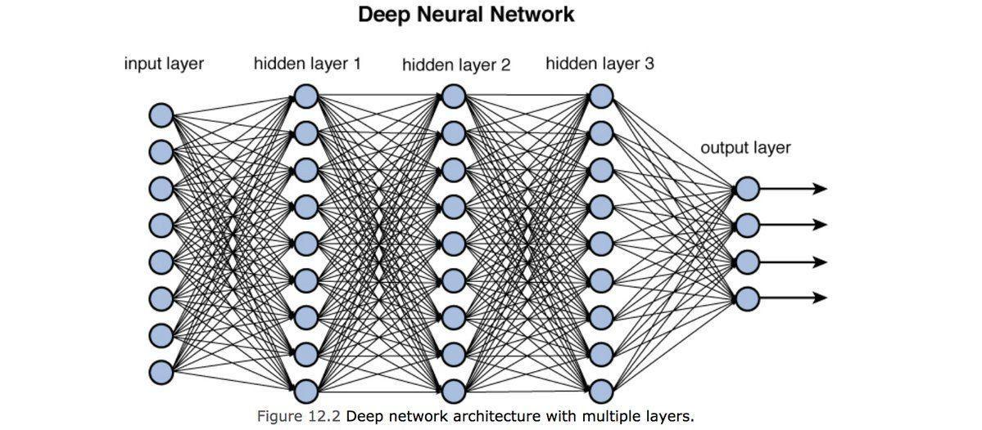
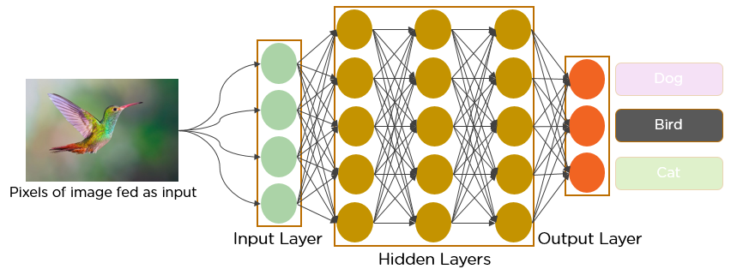
Deep Learning
Deep Neural Network (DNN)
A network of multiple layers of perceptron layers
https://towardsdatascience.com/training-deep-neural-networks-9fdb1964b964
https://www.analyticsvidhya.com/blog/2021/05/convolutional-neural-networks-cnn/
Notes:
The most basic form of Deep Learning is ‘Deep Neural Network’.
Just as the human brain learns through layers of neurons, it learns through layers of perceptron, or Deep Neural Network.
For example, if you enter an image into a DNN, you can automatically extract and learn features of images via layers of perceptron.
Like this, DNN is more powerful than traditional Machine Learning, but they are more complex, more capacity, and slower.
So there’s two things.
First, models that developed DNN to learn from data more efficiently have emerged. Second, the subsequent model is designed to be able to learn according to the characteristics of the data. Data could be images, language or time-series. In the next chapter, we will look at CNN, RNN models from DNN.

Slide 10
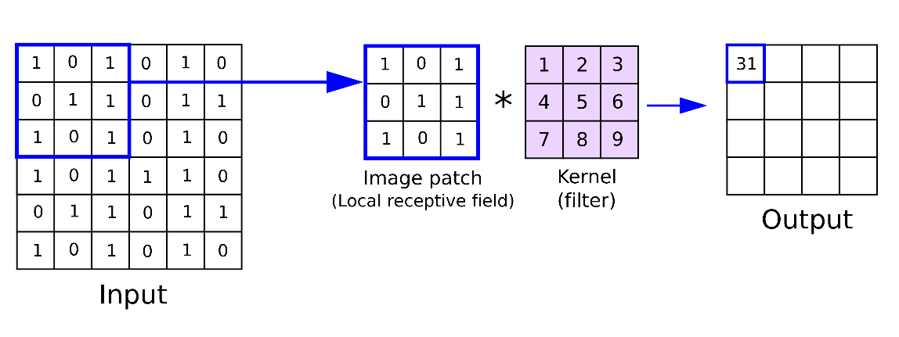

Deep Learning
CNN (Convolution Neural Network)
https://towardsdatascience.com/covolutional-neural-network-cb0883dd6529
Notes:
CNN is mainly used by Computer vision as a deep learning algorithm that processes images. It uses a matrix called filter or kernel to extract features from the image.
CNN is very powerful, but it has some problems to learn ordered data like language sentences or time-series.

Slide 11
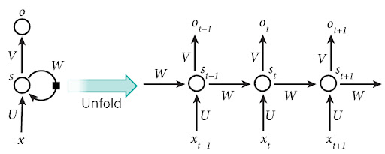
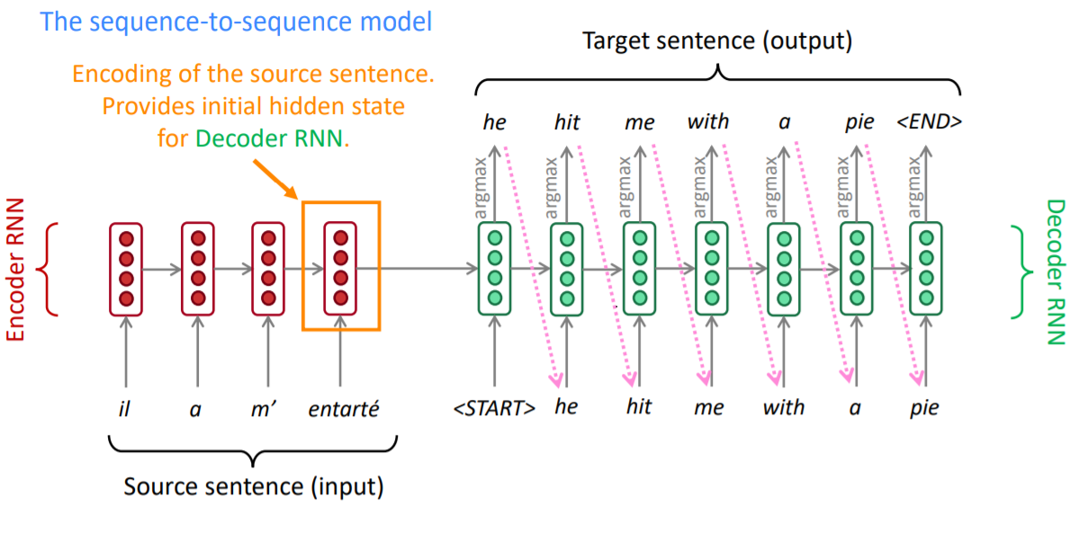
Deep Learning
RNN (Recursive Neural Network)
https://aikorea.org/blog/rnn-tutorial-1/
https://medium.com/analytics-vidhya/neural-machine-translation-using-bahdanau-attention-mechanism-d496c9be30c3
Notes:
RNN is designed for ordered data.
So it can be used for time-series data. When we learn RNN, the first entered data affects the next entered data by using a circular structure. We mainly used in Natural Language Processing.
The figure in the upper right is RNN, and the figure in the center is Seq2
It consists of two RNNs.
This picture is Machine Translation using RNN.
I'll give you a very simple and easy example.
When translating a sentence, the subject affects the form of the verb. In other words, you have to pass the information of entered data to the next entering data so that it can be learned together.

Slide 12
Natural Language Processing (NLP)
Notes:
Deep dive into NLP

Slide 13
NLP?
‘Interactions between computers and human language’
A subfield of linguistics, computer science, and artificial intelligence
Programming computers to process and analyze large amounts of natural language data.
The goal is a computer capable of "understanding" the contents of documents, including the contextual nuances of the language within them.
Notes:
Wikipedia NLP
Natural language processing (NLP) is a subfield of linguistics, computer science, and artificial intelligence concerned with the interactions between computers and human language, in particular how to program computers to process and analyze large amounts of natural language data. The goal is a computer capable of "understanding" the contents of documents, including the contextual nuances of the language within them. The technology can then accurately extract information and insights contained in the documents as well as categorize and organize the documents themselves.
Challenges in natural language processing frequently involve speech recognition, natural-language understanding, and natural-language generation.
자연어 처리 ( NLP )는 컴퓨터와 인간 언어 간의 상호 작용, 특히 대량의 자연어 데이터 를 처리하고 분석하기 위해 컴퓨터를 프로그래밍하는 방법과 관련된 언어학 , 컴퓨터 과학 및 인공 지능 의 하위 분야입니다. 목표는 문서 내 언어의 문맥적 뉘앙스를 포함하여 문서의 내용을 "이해"할 수 있는 컴퓨터입니다. 그러면 이 기술은 문서에 포함된 정보와 통찰력을 정확하게 추출하고 문서 자체를 분류 및 구성할 수 있습니다.
자연어 처리의 문제에는 종종 음성 인식 , 자연어 이해 및 자연어 생성이 포함 됩니다.

Slide 14


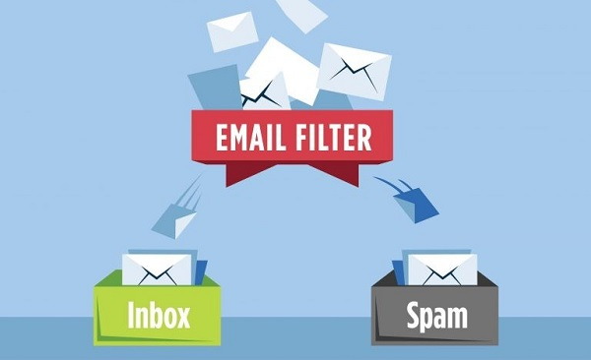

Field of application
Chatbot
Alexa, Siri, Bixby.
Text Summarization
Google search
Document Classification
Spam mail filtering
Machine Translation
Google Translate
https://www.mvtvwireless.com/why-are-my-emails-going-into-spam/
Notes:
자연어처리는 인간의 언어를 이용하는 모든 컴퓨터과학 분야에서 사용됩니다.
Natural language processing is used in all areas of computer science that use human language.
chatbot : communicate with human

Slide 15
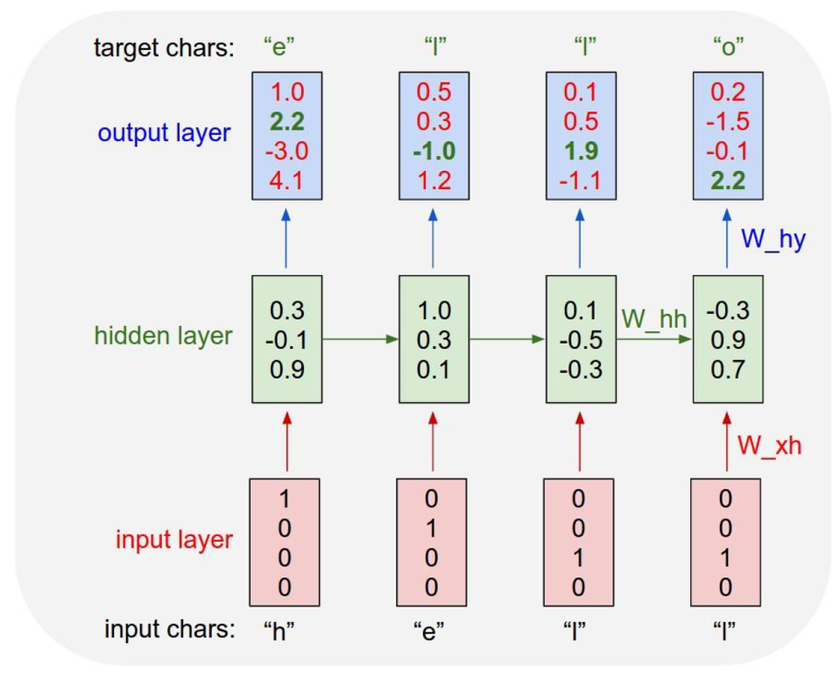
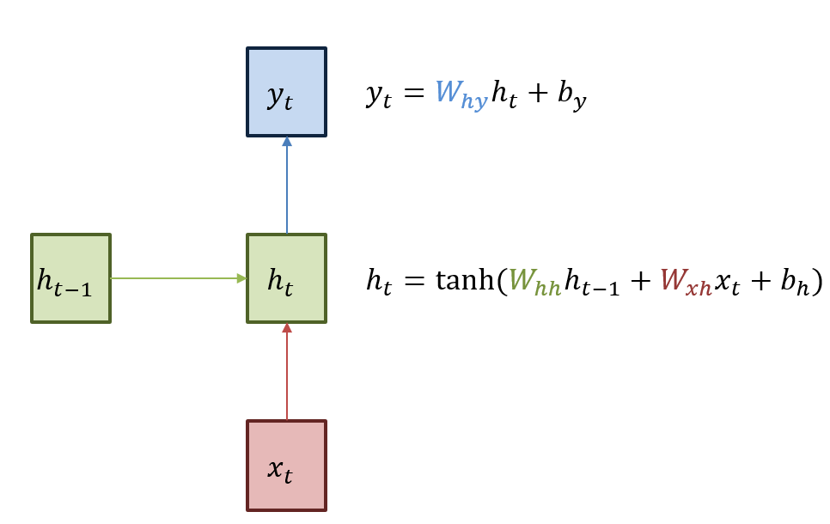
RNN
https://aikorea.org/blog/rnn-tutorial-1/
https://ratsgo.github.io/natural%20language%20processing/2017/03/09/rnnlstm/
Notes:
This is simple figure of RNN.
It has Recursive logic here.
x is input, and w is weight.
And this circle point is hidden layer.
Human language is made by sequences.
이건 ordered data 라는 뜻.
data order 가 중요하고, previous data 가 current data 에 영향 끼침 (effects)
따라서 이전의 정보와 현재의 정보를 합쳐 현재의 output 을 만든다.
Therefore, the previous and current information are combined to create the current output.

Slide 16
Seq2Seq
https://medium.com/analytics-vidhya/neural-machine-translation-using-bahdanau-attention-mechanism-d496c9be30c3
Notes:
Seq2seq는 하나의 시퀀스를 다른 시퀀스로 바꿉니다( 시퀀스 변환 ). RNN( 재귀 신경망 ) 또는 더 자주 LSTM 또는 GRU 를 사용 하여 그래디언트 소실 문제를 방지 합니다 . 각 항목의 컨텍스트는 이전 단계의 출력입니다. 기본 구성 요소는 하나의 인코더와 하나의 디코더 네트워크입니다. 인코더는 각 항목을 해당 항목과 해당 컨텍스트를 포함하는 숨겨진 벡터로 바꿉니다. 디코더는 프로세스를 반대로 하여 이전 출력을 입력 컨텍스트로 사용하여 벡터를 출력 항목으로 바꿉니다. ^{[2]}
Seq2seq turns one sequence into another sequence (sequence transformation). It does so by use of a recurrent neural network (RNN) or more often LSTM or GRU to avoid the problem of vanishing gradient. The context for each item is the output from the previous step. The primary components are one encoder and one decoder network. The encoder turns each item into a corresponding hidden vector containing the item and its context. The decoder reverses the process, turning the vector into an output item, using the previous output as the input context.^{[2]}
Seq2Seq
https://pytorch.org/tutorials/intermediate/seq2seq_translation_tutorial.html
이것은 Seq2Seq 을 이용한 번역 모델입니다.
This is figure of machine translation model by seq2seq.
하나의 시퀀스를 다른 시퀀스로 바꾸는 두개의 RNN이 함께 동작하는 sequence to sequence network 의 간단하지만 강력한 아이디어가 번역을 가능하게 합니다. 인코더 네트워크는 입력 시퀀스를 벡터로 압축하고, 디코더 네트워크는 해당 벡터를 새로운 시퀀스로 펼칩니다.
Translation is made possible by the simple but powerful idea of the sequence to sequence network, in which two recurrent neural networks work together to transform one sequence to another. An encoder network condenses an input sequence into a vector, and a decoder network unfolds that vector into a new sequence.
Recurrent Neural Network(RNN)는 시퀀스에서 작동하고 다음 단계의 입력으로 자신의 출력을 사용하는 네트워크입니다.
Sequence to Sequence network, 또는 Seq2Seq 네트워크, 또는 Encoder Decoder network 는 인코더 및 디코더라고 하는 두 개의 RNN으로 구성된 모델입니다. 인코더는 입력 시퀀스를 읽고 단일 벡터를 출력하고, 디코더는 해당 벡터를 읽어 출력 시퀀스를 생성합니다.
A Recurrent Neural Network, or RNN, is a network that operates on a sequence and uses its own output as input for subsequent steps.
A Sequence to Sequence network, or seq2seq network, or Encoder Decoder network, is a model consisting of two RNNs called the encoder and decoder. The encoder reads an input sequence and outputs a single vector, and the decoder reads that vector to produce an output sequence.
모든 입력에 해당하는 출력이 있는 단일 RNN의 시퀀스 예측과 달리 Seq2Seq 모델은 시퀀스 길이와 순서를 자유롭게하기 때문에 두 언어 사이의 번역에 이상적입니다.
다음 문장 “Je ne suis pas le chat noir” → “I am not the black cat” 를 살펴 봅시다. 입력 문장의 단어 대부분은 출력 문장에서 직역(“chat noir” 와 “black cat”)되지만 약간 다른 순서도 있습니다. “ne/pas” 구조로 인해 입력 문장에 단어가 하나 더 있습니다. 입력 단어의 시퀀스를 직역해서 정확한 번역을 만드는 것은 어려울 것입니다.
Seq2Seq 모델을 사용하면 인코더는 하나의 벡터를 생성합니다. 이상적인 경우에 입력 시퀀스의 “의미”를 문장의 N 차원 공간에 있는 단일 지점인 단일 벡터로 인코딩합니다.
Unlike sequence prediction with a single RNN, where every input corresponds to an output, the seq2seq model frees us from sequence length and order, which makes it ideal for translation between two languages.
Consider the sentence “Je ne suis pas le chat noir” → “I am not the black cat”. Most of the words in the input sentence have a direct translation in the output sentence, but are in slightly different orders, e.g. “chat noir” and “black cat”. Because of the “ne/pas” construction there is also one more word in the input sentence. It would be difficult to produce a correct translation directly from the sequence of input words.
With a seq2seq model the encoder creates a single vector which, in the ideal case, encodes the “meaning” of the input sequence into a single vector — a single point in some N dimensional space of sentences.
인코더
Seq2Seq 네트워크의 인코더는 입력 문장의 모든 단어에 대해 어떤 값을 출력하는 RNN입니다. 모든 입력 단어에 대해 인코더는 벡터와 은닉 상태를 출력하고 다음 입력 단어를 위해 그 은닉 상태를 사용합니다.
The encoder of a seq2seq network is a RNN that outputs some value for every word from the input sentence. For every input word the encoder outputs a vector and a hidden state, and uses the hidden state for the next input word.
디코더
디코더는 인코더 출력 벡터를 받아서 번역을 생성하기 위한 단어 시퀀스를 출력합니다.
가장 간단한 Seq2Seq 디코더는 인코더의 마지막 출력만을 이용합니다. 이 마지막 출력은 전체 시퀀스에서 문맥을 인코드하기 때문에 문맥 벡터(context vector) 로 불립니다. 이 문맥 벡터는 디코더의 초기 은닉 상태로 사용 됩니다.
디코딩의 매 단계에서 디코더에게 입력 토큰과 은닉 상태가 주어집니다. 초기 입력 토큰은 문자열-시작 (start-of-string) <SOS> 토큰이고, 첫 은닉 상태는 문맥 벡터(인코더의 마지막 은닉 상태) 입니다
The decoder is another RNN that takes the encoder output vector(s) and outputs a sequence of words to create the translation.
In the simplest seq2seq decoder we use only last output of the encoder. This last output is sometimes called the context vector as it encodes context from the entire sequence. This context vector is used as the initial hidden state of the decoder.
At every step of decoding, the decoder is given an input token and hidden state. The initial input token is the start-of-string <SOS> token, and the first hidden state is the context vector (the encoder’s last hidden state).

Slide 17
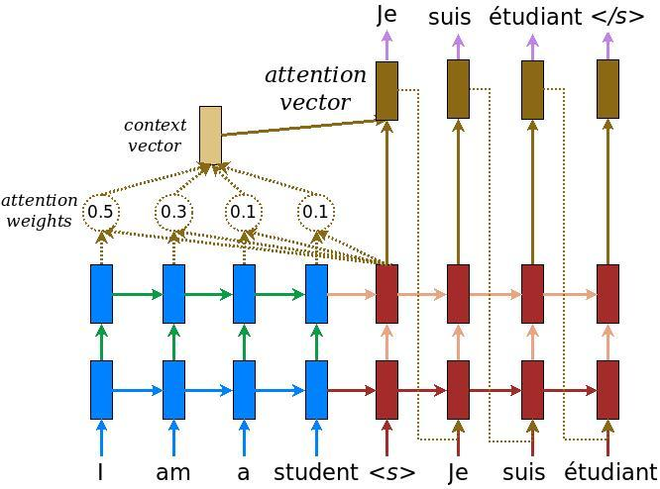
Seq2Seq + ‘Attention’
Decoder learn to focus over a specific range of the input sequence
https://www.tensorflow.org/text/tutorials/nmt_with_attention
Notes:
Attn
문맥 벡터만 인코더와 디코더 사이로 전달 된다면, 단일 벡터가 전체 문장을 인코딩 해야하는 부담을 가지게 됩니다.
If only the context vector is passed between the encoder and decoder, that single vector carries the burden of encoding the entire sentence.
이것이 병목현상입니다.
It’s ‘Bottleneck’
이 문제를 개선하기 위해 Attention Mechanism 을 사용하면 디코더가 입력 시퀀스의 특정 범위에 집중할 수 있도록 합니다.
To improve upon this problem we’ll use an attention mechanism, which lets the decoder learn to focus over a specific range of the input sequence.
Attention은 디코더 네트워크가 자기 출력의 모든 단계에서 인코더 출력의 다른 부분에 “집중” 할 수 있게 합니다. 첫째 Attention 가중치 의 세트를 계산합니다. 이것은 가중치 조합을 만들기 위해서 인코더 출력 벡터와 곱해집니다. 그 결과는 입력 시퀀스의 특정 부분에 관한 정보를 포함해야하고 따라서 디코더가 알맞은 출력 단어를 선택하는 것을 도와줍니다.
Attention allows the decoder network to “focus” on a different part of the encoder’s outputs for every step of the decoder’s own outputs. First we calculate a set of attention weights. These will be multiplied by the encoder output vectors to create a weighted combination. The result should contain information about that specific part of the input sequence, and thus help the decoder choose the right output words.

Slide 18

Transformer
‘Attention is All you Need’
https://jalammar.github.io/illustrated-transformer/
Notes:
Attn 만으로 모델 구현.
현재 자연어처리는 트포 전/후로 나뉜다!
BERT 와 GPT 의 original source
우리는 반복과 컨볼루션을 완전히 배제하고 어텐션 메커니즘만을 기반으로 하는 새로운 간단한 네트워크 아키텍처인 Transformer를 제안한다.
Transformer is a new simple network architecture, based solely on attention mechanisms, dispensing with recurrence and convolutions entirely.

Slide 19
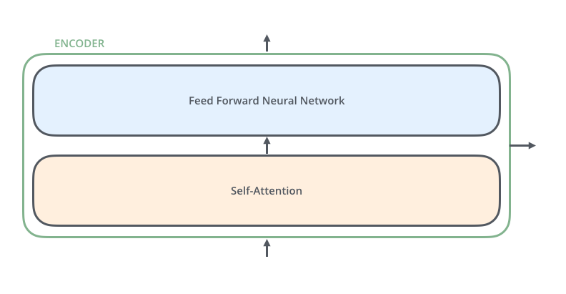

Transformer
Encoder – Decoder (6-6)
https://jalammar.github.io/illustrated-transformer/
Notes:
The encoding component is a stack of encoders (the baseline stacks six layer each.). The decoding component is a stack of decoders of the same number.
인코딩 컴포넌트는 인코더의 스택이다(종이는 6개의 인코더를 서로 겹쳐 쌓는다). 디코딩 컴포넌트는 동일한 수의 디코더들의 스택이다.
The encoders are all identical in structure (yet they do not share weights). Each one is broken down into two sub-layers:
인코더는 구조가 모두 동일하지만 가중치를 공유하지는 않는다. 각 계층은 두 개의 하위 계층으로 나뉩니다.
Feed-Forward Neural Network 와 Self-Attention layer 입니다.
Feed-Forward Neural Network and Self-Attention layer.

Slide 20

Transformer
FFNN & Self-Attn in Encoder
https://jalammar.github.io/illustrated-transformer/
Notes:
The encoder’s inputs first flow through a self-attention layer – a layer that helps the encoder look at other words in the input sentence as it encodes a specific word. We’ll look closer at self-attention later in the post.
The outputs of the self-attention layer are fed to a feed-forward neural network. The exact same feed-forward network is independently applied to each position.
The decoder has both those layers, but between them is an attention layer that helps the decoder focus on relevant parts of the input sentence (similar what attention does in seq2seq models).
인코더의 입력은 먼저 셀프 어텐션 레이어를 통해 흐른다. 이 레이어는 인코더가 특정 단어를 인코딩할 때 입력 문장의 다른 단어를 볼 수 있도록 도와준다. 우리는 나중에 게시물에서 자기 주의에 대해 더 자세히 살펴볼 것이다.
자기 주의 계층의 출력은 피드포워드 신경망에 공급된다. 정확히 동일한 피드포워드 네트워크가 각 위치에 독립적으로 적용된다.
디코더는 두 개의 레이어를 모두 가지고 있지만, 그 사이에 디코더가 입력 문장의 관련 부분에 초점을 맞출 수 있도록 도와주는 주의 레이어가 있다(seq2seq 모델에서 주의가 수행하는 것과 유사).

Slide 21
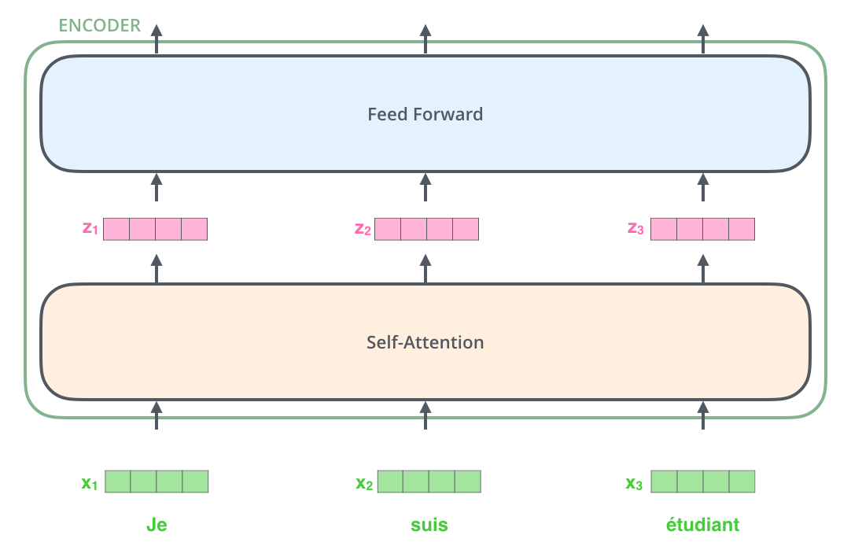
Transformer
Input embedding
https://jalammar.github.io/illustrated-transformer/
Notes:
Now that we’ve seen the major components of the model, let’s start to look at the various vectors/tensors and how they flow between these components to turn the input of a trained model into an output.
As is the case in NLP applications in general, we begin by turning each input word into a vector using an embedding algorithm.
모델의 주요 구성 요소를 살펴보았으므로, 이제 다양한 벡터/텐서 및 이러한 구성 요소 간에 어떻게 흘러가 훈련된 모델의 입력을 출력으로 전환하는지 살펴보겠습니다.
일반적으로 NLP 애플리케이션의 경우와 마찬가지로, 임베딩 알고리듬을 사용하여 각 입력 단어를 벡터로 변환하는 것으로 시작한다.
Each word is embedded into a vector of size 512. We'll represent those vectors with these simple boxes.
각 단어는 512 크기의 벡터에 내장되어 있다. 우리는 이 간단한 상자로 벡터를 표현할 것입니다.
The embedding only happens in the bottom-most encoder.
임베딩은 맨 아래 인코더에서만 발생합니다.

Slide 22
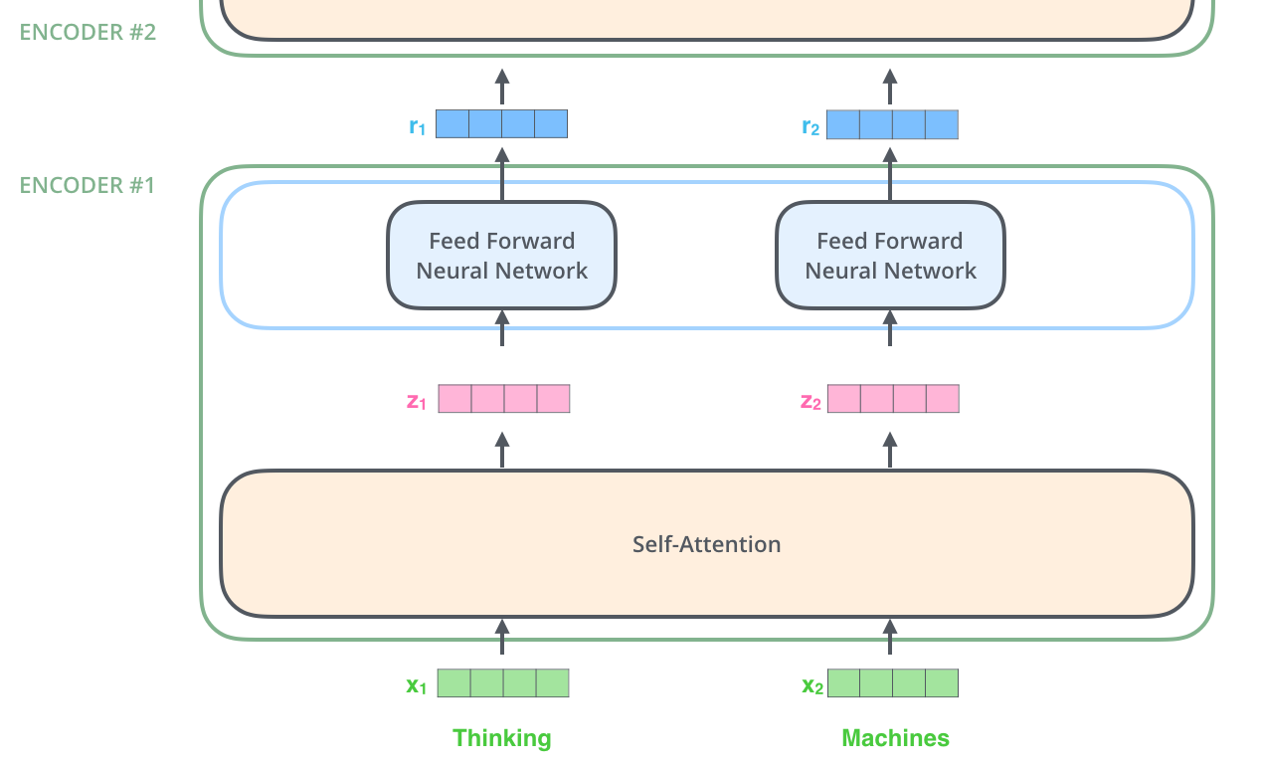
Transformer
Encoding
https://jalammar.github.io/illustrated-transformer/
Notes:
As we’ve mentioned already, an encoder receives a list of vectors as input. It processes this list by passing these vectors into a ‘self-attention’ layer, then into a feed-forward neural network, then sends out the output upwards to the next encoder.
이미 언급했듯이, 인코더는 벡터 목록을 입력으로 수신한다. 이 벡터는 이러한 벡터를 '자기 주의' 계층으로 전달한 다음 피드포워드 신경망에 전달하여 이 목록을 처리하고 출력을 다음 인코더로 위쪽으로 전송한다.

Slide 23

Transformer
Self-Attention
https://jalammar.github.io/illustrated-transformer/
Notes:
Say the following sentence is an input sentence we want to translate:
다음 문장이 번역하고자 하는 입력 문장이라고 가정합시다.
”The animal didn't cross the street because it was too tired”
What does “it” in this sentence refer to? Is it referring to the street or to the animal? It’s a simple question to a human, but not as simple to an algorithm.
When the model is processing the word “it”, self-attention allows it to associate “it” with “animal”.
As the model processes each word (each position in the input sequence), self attention allows it to look at other positions in the input sequence for clues that can help lead to a better encoding for this word.
이 문장에서 "그것"은 무엇을 의미합니까? 거리를 말하는 건가요, 동물을 말하는 건가요? 이것은 인간에게는 간단한 질문이지만 알고리즘에게는 간단하지 않다.
모델이 "그것"이라는 단어를 처리할 때, 자기관심은 "그것"을 "동물"과 연관시킬 수 있게 한다.
모델이 각 단어(입력 시퀀스의 각 위치)를 처리할 때 셀프 어텐션은 입력 시퀀스의 다른 위치를 확인하여 이 단어를 더 잘 인코딩하는 데 도움이 되는 단서를 찾을 수 있도록 한다.

Slide 24


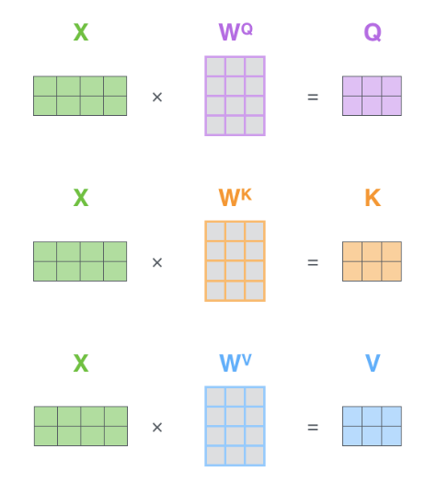
Transformer
Self-Attention
Matrix Calculation of Self-Attention
https://jalammar.github.io/illustrated-transformer/
Notes:
Let’s first look at how to calculate self-attention using vectors, then proceed to look at how it’s actually implemented – using matrices.
The first step in calculating self-attention is to create three vectors from each of the encoder’s input vectors (in this case, the embedding of each word). So for each word, we create a Query vector, a Key vector, and a Value vector. These vectors are created by multiplying the embedding by three matrices that we trained during the training process.
먼저 벡터를 사용하여 셀프 어텐션을 계산하는 방법을 살펴본 후 매트릭스를 사용하여 실제로 어떻게 구현되는지 살펴보겠습니다. 셀프 어텐션을 계산하는 첫 번째 단계는 인코더의 각 입력 벡터(이 경우 각 단어의 임베딩)에서 3개의 벡터를 생성하는 것이다. 따라서 각 단어에 대해 쿼리 벡터, 키 벡터 및 값 벡터를 만듭니다. 이러한 벡터는 임베딩에 훈련 과정 동안 훈련한 세 개의 행렬을 곱하여 생성된다.
Multiplying x1 by the WQ weight matrix produces q1, the "query" vector associated with that word. We end up creating a "query", a "key", and a "value" projection of each word in the input sentence.
x1에 WQ 가중치 행렬을 곱하면 해당 단어와 연관된 쿼리 벡터인 q1이 생성된다. 우리는 결국 입력 문장에서 각 단어의 "쿼리", "키" 및 "값" 투영을 만듭니다.
The second step in calculating self-attention is to calculate a score. The score determines how much focus to place on other parts of the input sentence as we encode a word at a certain position.
The score is calculated by taking the dot product of the query vector with the key vector of the respective word we’re scoring. So if we’re processing the self-attention for the word in position #1, the first score would be the dot product of q1 and k1. The second score would be the dot product of q1 and k2.
자기 주의 계산의 두 번째 단계는 점수를 계산하는 것이다. 점수는 특정 위치에서 단어를 인코딩할 때 입력 문장의 다른 부분에 얼마나 초점을 맞출지를 결정합니다.
점수는 우리가 채점하고 있는 각 단어의 키 벡터와 함께 쿼리 벡터의 점 곱을 취하여 계산된다. 따라서 위치 #1에 있는 단어에 대한 자체 주의를 처리하면 첫 번째 점수는 q1과 k1의 점 곱이 됩니다. 두 번째 점수는 q1과 k2의 점 곱이 될 것이다.
The third and fourth steps are to divide the scores by 8 (the square root of the dimension of the key vectors used in the paper – 64. This leads to having more stable gradients.
There could be other possible values here, but this is the default), then pass the result through a softmax operation.
Softmax normalizes the scores so they’re all positive and add up to 1.
세 번째와 네 번째 단계는 점수를 8로 나누는 것이다(논문에 사용된 핵심 벡터의 치수의 제곱근 - 64). 이는 보다 안정적인 그레이디언트를 갖는 것으로 이어진다.
여기에는 다른 가능한 값이 있을 수 있지만 이 값은 기본값입니다.) 그런 다음 결과를 소프트맥스 연산을 통해 전달합니다.
Softmax는 점수를 정규화하여 모두 긍정적이고 합쳐서 1이 됩니다.
The fifth step is to multiply each value vector by the softmax score (in preparation to sum them up).
The intuition here is to keep intact the values of the word(s) we want to focus on, and drown-out irrelevant words (by multiplying them by tiny numbers like 0.001, for example).
The sixth step is to sum up the weighted value vectors.
This produces the output of the self-attention layer at this position (for the first word).
다섯 번째 단계는 각 값 벡터에 소프트맥스 점수를 곱하는 것이다.
여기서의 직관은 우리가 초점을 맞추고자 하는 단어의 값을 그대로 유지하고 무관한 단어들을 지우는 것이다(예를 들어, 0.001과 같은 작은 숫자들을 곱함으로써).
여섯 번째 단계는 가중치 벡터를 합산하는 것이다.
이것은 (첫 번째 단어에 대한) 이 위치에서 자기 주의 계층의 출력을 생성한다.

Slide 25
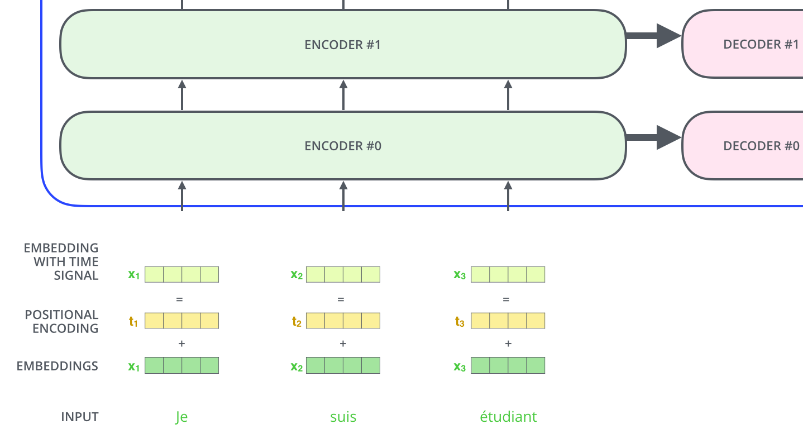
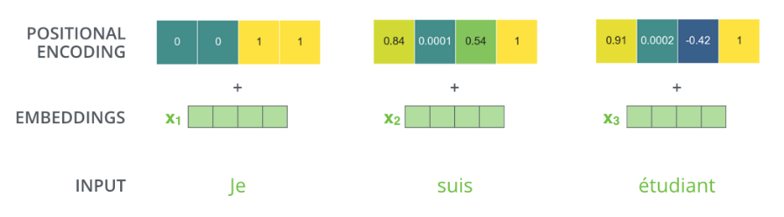
Transformer
Positional Encoding
https://jalammar.github.io/illustrated-transformer/
Notes:
One thing that’s missing from the model as we have described it so far is a way to account for the order of the words in the input sequence.
To give the model a sense of the order of the words, we add positional encoding vectors -- the values of which follow a specific pattern.
지금까지 설명한 바와 같이 모델에서 빠진 한 가지는 입력 시퀀스에서 단어의 순서를 설명하는 방법입니다.
모델에 단어 순서에 대한 감각을 주기 위해, 우리는 위치 인코딩 벡터를 추가한다. 이 벡터의 값은 특정 패턴을 따른다.

Slide 26

Transformer
Detail process in encoder & decoder
https://jalammar.github.io/illustrated-transformer/
Notes:
Residual connection

Slide 27

Transformer
Decoder
https://jalammar.github.io/illustrated-transformer/
Notes:
After finishing the encoding phase, we begin the decoding phase. Each step in the decoding phase outputs an element from the output sequence (the English translation sentence in this case).
인코딩 단계를 완료한 후 디코딩 단계를 시작합니다. 디코딩 단계의 각 단계는 출력 시퀀스(이 경우 영어 번역문)에서 요소를 출력합니다.

Slide 28

Transformer
Decoder
https://jalammar.github.io/illustrated-transformer/
Notes:
The following steps repeat the process until a special symbol is reached indicating the transformer decoder has completed its output. The output of each step is fed to the bottom decoder in the next time step, and the decoders bubble up their decoding results just like the encoders did. And just like we did with the encoder inputs, we embed and add positional encoding to those decoder inputs to indicate the position of each word.
다음 단계는 변압기 디코더가 출력을 완료했음을 나타내는 특수 기호에 도달할 때까지 프로세스를 반복합니다. 각 단계의 출력은 다음 시간 단계에서 하단 디코더로 공급되고 디코더는 인코더와 마찬가지로 디코딩 결과를 버블업한다. 그리고 우리가 인코더 입력에서 했던 것처럼, 우리는 각 단어의 위치를 나타내기 위해 디코더 입력에 위치 인코딩을 내장하고 추가한다.
The self attention layers in the decoder operate in a slightly different way than the one in the encoder:
In the decoder, the self-attention layer is only allowed to attend to earlier positions in the output sequence. This is done by masking future positions (setting them to -inf) before the softmax step in the self-attention calculation.
The “Encoder-Decoder Attention” layer works just like multiheaded self-attention, except it creates its Queries matrix from the layer below it, and takes the Keys and Values matrix from the output of the encoder stack.
디코더의 셀프 어텐션 레이어는 인코더와 약간 다른 방식으로 작동합니다.
디코더에서 셀프 어텐션 레이어는 출력 시퀀스의 이전 위치에만 참석할 수 있다. 이 작업은 자체 주의 계산에서 소프트맥스 단계 전에 미래 위치를 마스킹(-inf로 설정)하여 수행됩니다.
"인코더-디코더 주의" 계층은 다중 헤드 자기 주의와 동일하게 작동하지만, 그 아래의 계층에서 쿼리 행렬을 만들고, 인코더 스택의 출력에서 키와 값 행렬을 가져온다.

Slide 29

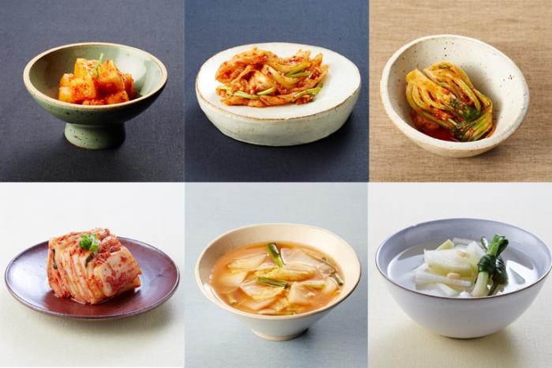
BERT
Quiz
Minjoo _________ kimchi
run
read
eat

Slide 30
BERT
Quiz
Minjoo _________ kimchi
run
read
eat
Notes:
너는 빈 칸 앞뒤의 양쪽 단어를 이용해 빈 칸의 단어를 추측할 수 있다.
You can guess the word in the blank using both words before and after the blank.
다시 말해, 너는 문맥을 이용할 수 있다.
In other words, you can use the context.
이것이 BERT 를 만든 기본 아이디어입니다.
This is the basic idea that created BERT.

Slide 31
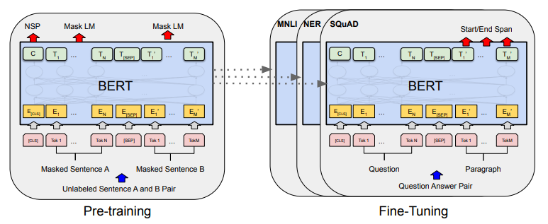
BERT
Bidirectional Encoder Representations from Transformers
Notes:
BERT’s full name is ~~~.
It is made by Transformer’s encoder.
BERT is designed to pre-train deep bidirectional representations from unlabeled text by jointly conditioning on both left and right context in all layers. As a result, the pre-trained BERT model can be fine-tuned with just one additional output layer to create state-of-the-art models for a wide range of tasks, such as question answering and language inference, without substantial task-specific architecture modifications.
BERT는 모든 레이어의 왼쪽 및 오른쪽 컨텍스트에서 공동으로 조정하여 레이블이 지정되지 않은 텍스트에서 심층 양방향 표현을 사전 훈련하도록 설계되었다. 결과적으로, 사전 훈련된 BERT 모델은 실질적인 작업별 아키텍처 수정 없이 질문 응답 및 언어 추론과 같은 광범위한 작업에 대한 최첨단 모델을 생성하기 위해 하나의 추가 출력 계층으로 미세 조정할 수 있다.

Slide 32
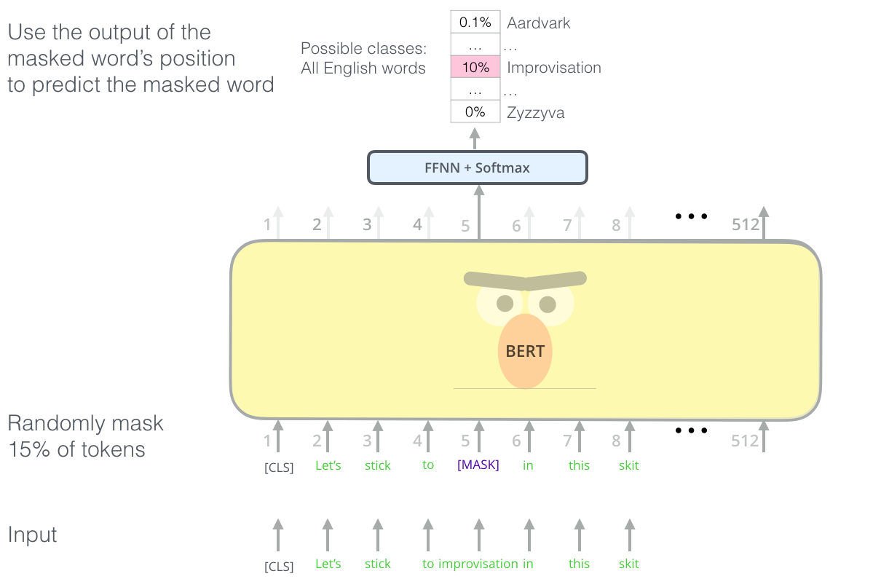
BERT
Masked Language Model
Notes:
BERT 는 빈 칸 채우기 퀴즈처럼 학습한다.
BERT trains like a blank filling quiz.
BERT의 영리한 언어 모델링 작업은 입력에서 단어의 15%를 마스크하고 모델에 누락된 단어를 예측하도록 요청한다.
BERT's clever language modeling task masks 15% of words in the input and asks the model to predict the missing word.

Slide 33
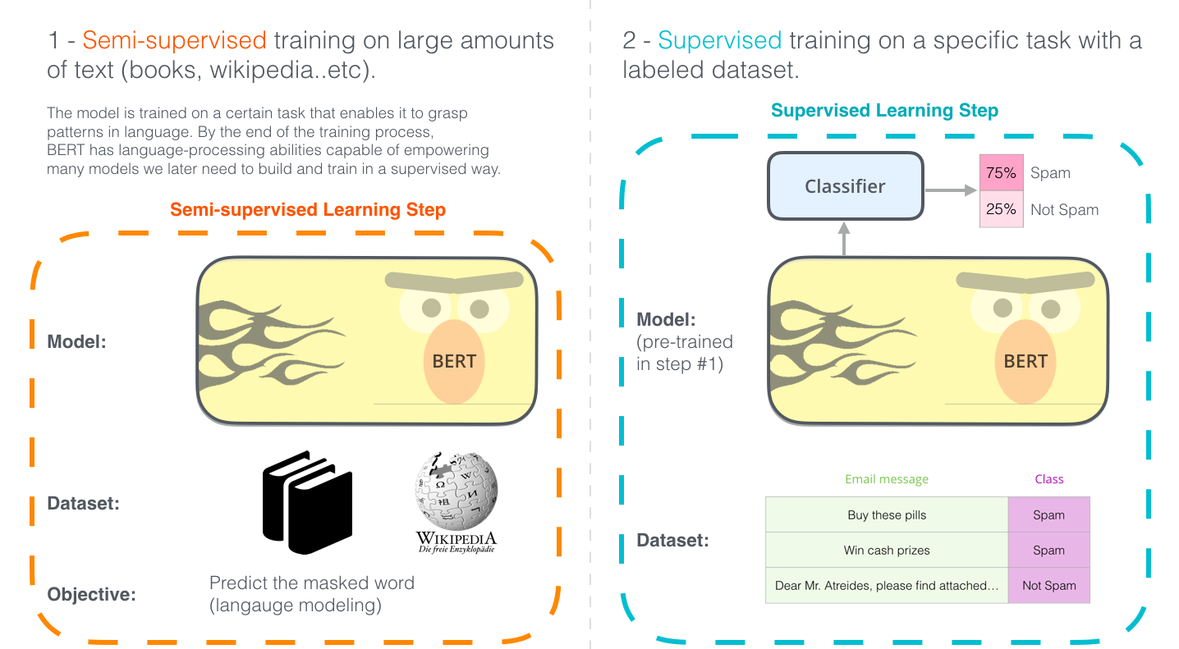
BERT
Pre-trained model
Notes:
The two steps of how BERT is developed. You can download the model pre-trained in step 1 (trained on un-annotated data), and only worry about fine-tuning it for step 2
BERT가 개발되는 방법의 두 단계입니다. 1단계에서 사전 교육한 모델(주석 없는 데이터에 대해 교육됨)을 다운로드하고 2단계에서는 미세 조정만 할 수 있습니다.

Slide 34
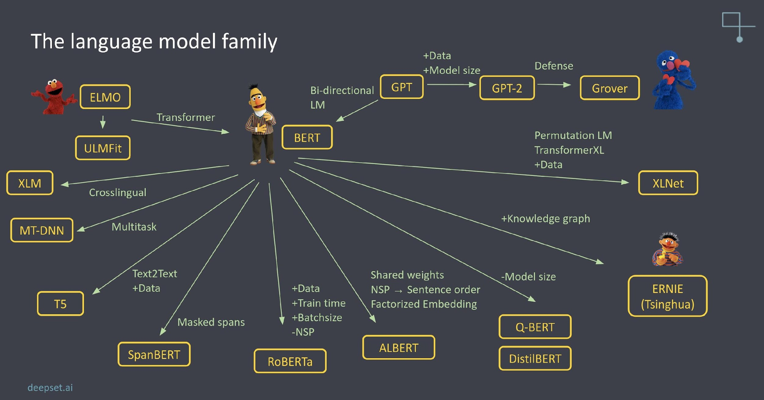
Family of BERT
Notes:
BERT 는 매우 강력한 모델로, 대가족을 이룹니다.
BERT is a very powerful model, making up a large family.
BERT 를 경량화한 ALBERT 및 DistilBERT, 널리 쓰이는 RoBERTa,
Crosslingual 을 지원하는 XLM 이 대표적인 BERT 의 자손이며
GPT 는 transformer 의 decoder 를 이용하였기에 BERT 의 형제입니다.
ALBERT and DistilBERT, the lighten model of BERT,
widely used RoBERTa, XLM, the crosslingual model are descendant of BERT, GPT is BERT's brother because it used transformer's decoder.

Slide 35
Machine Translation

Slide 36





Machine Translation?
Process when a computer software translates text from one language to another without human involvement

Slide 37
History
Rule Based Machine Translation
= PBMT (Phrase Based Machine Translation)
RBMT
Statistical Machine Translation
SMT
Neural Machine Translation (by AI)
Trained with sequence
NMT

Slide 38
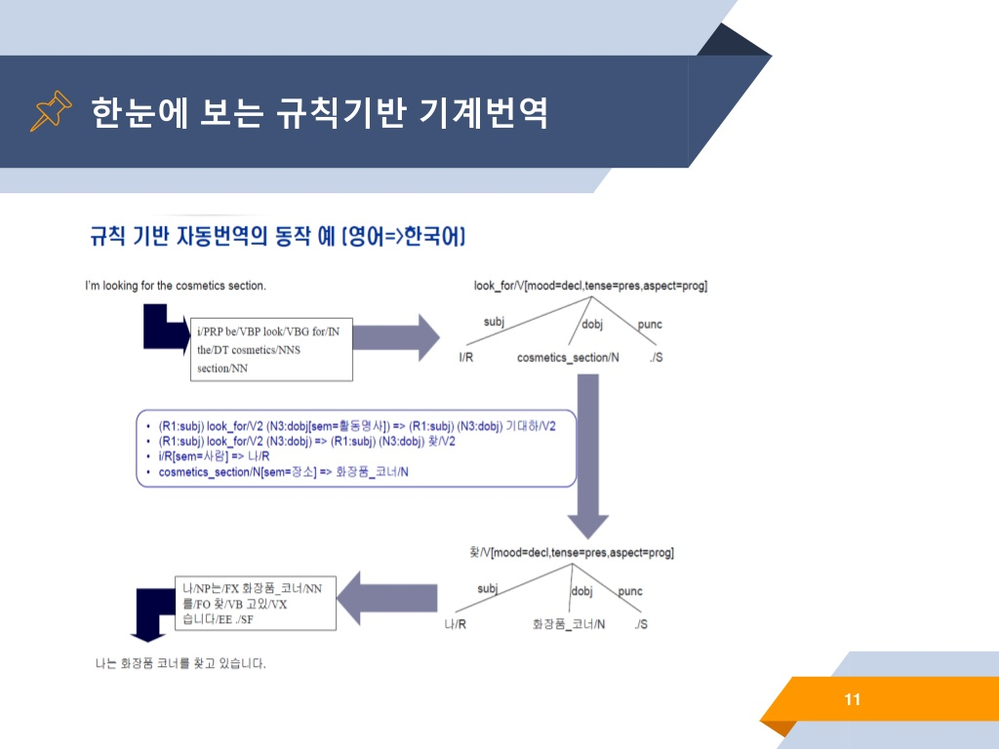
RBMT : Rule Based Machine Translation
https://www.slideshare.net/NaverEngineering/mt-173570380
Notes:
• 두 언어의 문법 규칙(Rule)을 기반으로 개발.
• 문법 규칙(Rule) 추출의 어려움
번역 언어 확장의 어려움
Developed on the basis of grammar rules in both languages.
Difficulty in extracting grammatical rules
Difficulty in expanding the translation language

Slide 39
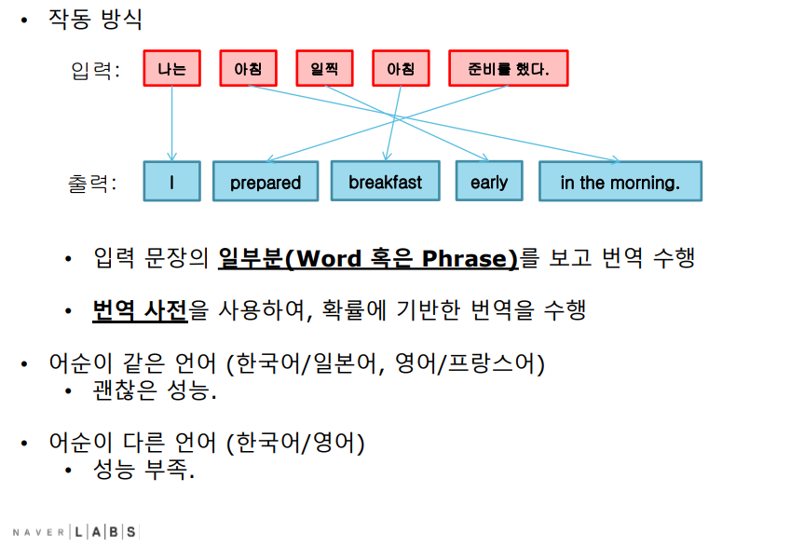
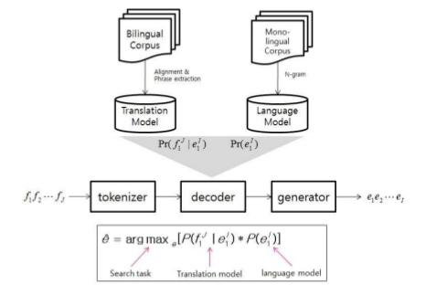
SMT : Statistical Machine Translation
Translate using word or phrase of input sentence
Statistical translation using a dictionary
Similar order language (Korean/Japanise, English/French) : Not Bad
Different order language (Korean/English) : BAD
https://www.slideshare.net/deview/papagon2mt
Notes:
통계 정보를 바탕으로 번역을 수행
한국어 입력 문장이 들어오면, 각 단어가 어떤 영어 단어로 번역될 확률이 얼마인지 데이터 테이블에서 읽어와 가장 확률 높은 단어를 찾는 방식
어쩌고 저쩌고…
입력 문장의 일부분 (Word or Phrase) 을 이용해 번역
번역 사전을 이용하여 확률 기반 번역
어순이 같은 언어
Translate using Word or Phrase
Statistical translation using a dictionary
a word order-like language

Slide 40
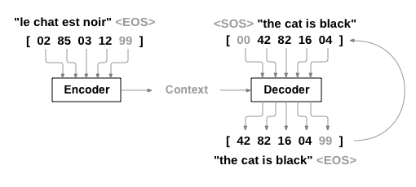
Neural Machine Translation (NMT)
Train translation model with language sentence pair
Dataset feature : [Source sentence] - [Target sentence]
Don’t need to build phrase analyzer / dictionary
Translate sentence by sentence -> Translate in context is possible
https://tutorials.pytorch.kr/_images/seq2seq.png
Notes:
Translate sentence by sentence -> can translate in context

Slide 41
Process to Develop NMT
NMT (Neural Machine Translation)
Get Raw Dataset
Preprocessing Dataset
Training Model
Evaluation
Notes:
From Get Raw Dataset to Training Model, this is a common step for all deep learning research as well as Neural machine translation.
First, prepare Raw Dataset.
I prepared a sentence pair dataset that translates Korean into English.
Second, preprocess this Raw Dataset.
I don't train the translation model with original sentences.
Separate sentences into words or smaller units.
Third, train the pre-processed data on the model.
This process involves selecting the right model and adjusting the hyperparameter of the model for better training.
Lastly, evaluate whether the machine translation model translates correctly.
An evaluation can be done by a human or by using probability-based indicators.

Slide 42
4 Elements of Machine Translation
Tokenization
Model Training
Inference Speed Optimization
Performance Optimization
Tokenize input
BPE (Byte Pair Encoding)
Model Learning Speed and Improve training quality
Speed up translation
Model Lightweight
Translation Quality Estimation
BLEU
Human Evaluation...
OUTPUT
MinJoo is really like an angel
Encoders
Decoders
BLEU score
50.81
MinJoo est vraiment un génie.
MinJoo est vraiment un génie.
MinJoo is really like a genius
INPUT
K.W.Jung in Naver Papago
Notes:
1. Preprocessing
Tokenize input sentences to each token.
Token can be a word or characters.
2. Model Training.
Explore how to improve model training speed and quality of training
The ultimate goal is model optimization.
3. Inference Speed Optimization
Improves the translation speed of the model.
To do this, reduce the model size and make it lighter so that it works on OnDevice.
In my opinion, this is the most difficult step.
You can compress and tune the model structure (algorithm).
You can also reduce or share model parameters.
However, translation performance may be somewhat degraded.
They tend to trade-off translation performance and speed.
The researchers who can do this are very high-level researchers and are difficult to employ.
4. Performance Optimization
It’s for translation quality evaluation and performance measurement of the model.
Compare the results of the translation model with the actual correct answer.
To do this, research Quality Estimation metrics.
and Study how to progress faster and more reliable Human Evaluation.

Slide 43
(1/4) Tokenization
Tokenize input sentence
내용이 정말 거지같다. → 내용/NNG 이/JKS 정말/MAG 거지/NNG 같/VA 다/EF ./SF
Tokenizer example : (KOR) Mecab, Okt / (EN) Moses / (ZH) Jieba / ...
BPE (Byte Pair Encoding)
Subword segmentation algorithm
OOV (Out Of Vocabulary) problem solved.
lowest -> low + est
https://github.com/rsennrich/subword-nmt
Notes:
문장을 word 또는 token 단위로 split.
Sentence piece 를 더 추천함.
Find the most consecutive pairs of characters and merge them into one character
연속적으로 가장 많이 등장한 글자의 쌍을 찾아서 하나의 글자로 병합

Slide 44
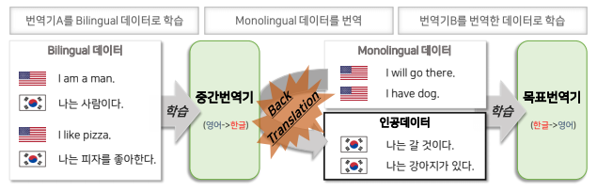
(2/4) Model Training
Model
Fast model training strategy / High-quality strategy
Dataset
Data Augmentation
Back-Translation
http://dsba.korea.ac.kr/seminar/?mod=document&uid=1328
Notes:
Dataset – Data Augmentation
Building method Bilingual dataset using monolingual dataset
It generates artificial data by NMT

Slide 45
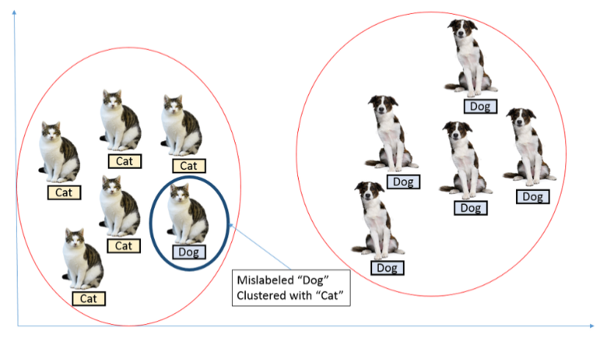
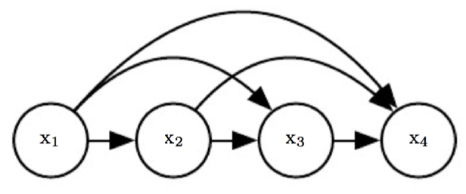
(2/4) Model Training
Optimization
Label Smoothing
Curriculum learning
Modeling
Non-Autoregressive
LSTM (Seq2Seq + Attention) → Transformer (Self-Attention)
https://3months.tistory.com/465
https://ratsgo.github.io/generative%20model/2018/01/31/AR/
Notes:
Label smoothing
이진 분류 문제에서 label 은 0 또는 1로 주어집니다. label 이 1이라고 하는 것은 그것의 label 이 1 임을 100 % 확신한다는 뜻입니다.
하지만 데이터 레이블링이 잘못되는 경우가 있을 수 있음.
이렇게 잘못된 레이블링의 영향을 줄이기 위해 label 을 0, 1이 아니라 smooth 하게 부여해 보자.
예를 들어 원래 0으로 부여되었던 label 의 경우 tensorflow 에서는 1-0.9 = 0.1 로 부여
mislabeling 된 데이터를 고려하기 위해 사용되는 것에 추가적으로 regularization(정규화)에도 효과가 있음.
For binary classification problems, labels are given either 0 or 1. When you say label 1, you're 100% sure that label is 1.
However, data labeling may be incorrect.
In order to reduce the influence of such incorrect labeling, let's give the label smoothly, not 0, 1.
For example, in the case of a label originally given as 0, the tensorflow gives 1-0.9 = 0.1
In addition to what is used to consider mislabeled data, it is also effective in regularization.
Curriculum learning
일반적으로 사람은 쉬운 것부터 차근차근 배워가면서 난이도를 점점 올려 어려운 것을 배우는 것이 학습 효과가 크다
Curriculum learning은 이 학습법을 차용한 것으로 상대적으로 쉬운 것부터 먼저 학습을 한 후 점차 어려운 것을 학습하는 머신 러닝 방법을 말한다
In general, people learn difficult things by increasing the level of difficulty while learning from easy things step by step
Curriculum learning refers to a machine learning method that learns relatively easy things first and then gradually learns difficult things
Non-Autoregressive
Auto regressive Model : 자기 자신을 입력으로 하여 자기 자신을 예측하는 모델
transformer 의 경우 decoder 측에서 i번째 output을 다시 i+1번째 input으로 사용하는 auto-regressive한 특성
최근 NMT 모델은 decoder 의 Auto regressive 한 특징이 있어 속도가 느림.
따라서 나이브한 방법으로 encoder-decoder 모델에서 auto-regressive 한 연결을 제거하는 방법이 있음.
하지만 성능이 떨어지므로 Non-Autoregressive Transformer 라는 새로운 모델이 소개됨.
이 모델은 전체 output 을 parallel 하게 생성 가능.
Auto reactive Model: A model that predicts itself by inputting itself
In the case of transformer, the auto-regressive characteristic of using the i-th output as the i+1th input on the decoder side again
The recent NMT model is slow due to the automatic reactive characteristics of decoder.
Therefore, there is a way to remove the auto-regressive connection from the encoder-decoder model in a nave way.
However, due to poor performance, a new model called Non-Autoregressive Transformer is introduced.
This model can generate the entire output parallelly.

Slide 46
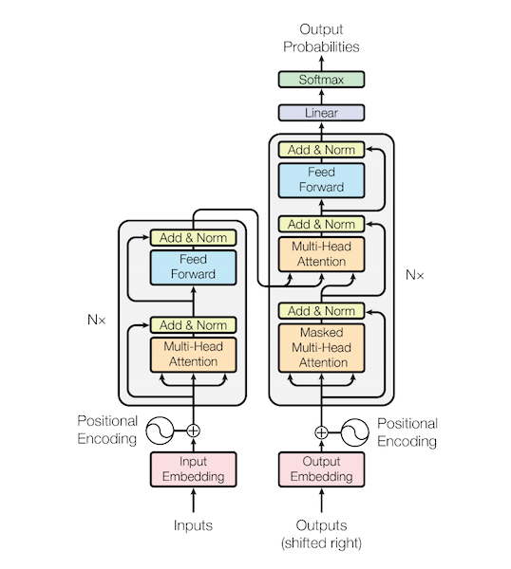
(2/4) Model Training
Seq2Seq+ Attention
Transformer (Self-Attention)
https://www.tensorflow.org/text/tutorials/nmt_with_attention
https://paul-hyun.github.io/transformer-03/
Notes:
Seq2seq
attention : Focus more on important words
전체 입력 문장을 전부 다 동일한 비율로 참고하는 것이 아니라, 해당 시점에서 예측해야할 단어와 연관이 있는 입력 단어 부분을 좀 더 집중(attention)해서 보게 됩니다.
Instead of referring to all input sentences at the same rate, we focus more on the input word parts that are related to the words to be predicted at that point.
Transformer
- ‘Attention Is All You Need’
-. attention 만으로도 입력 데이터에서 중요한 정보를 찾아내서 인코딩하기
With only attention , we can find important information and encoding it

Slide 47
(3/4) Performance Optimization
Measure performance of translation models
Evaluate translation quality
Compare translation results with reference
BLEU, ROUGE, RIBES...
Research about evaluation method better than BLEU
More fast, reliable Human Evaluation
Notes:
Human evaluations of machine translation are extensive but expensive. Human evaluations can take months to finish and involve human labor that can not be reused.
So many researchers proposed a method of automatic machine translation evaluation that is quick, inexpensive, and language-independent, that correlates highly with human evaluation, and that has little marginal cost per run.
기계 번역에 대한 인간의 평가는 광범위하지만 비용이 많이 든다. 인간 평가는 완료하는 데 몇 달이 걸릴 수 있으며 재사용할 수 없는 인간의 노동이 수반된다. 빠르고 저렴하며 언어 독립적인 자동 기계 번역 평가 방법을 제안하며, 이는 인간의 평가와 높은 상관관계를 가지며 실행당 한계 비용이 거의 없다.
How to make better Human evaluation?
More Faster, more …

Slide 48
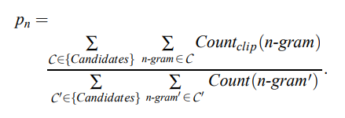
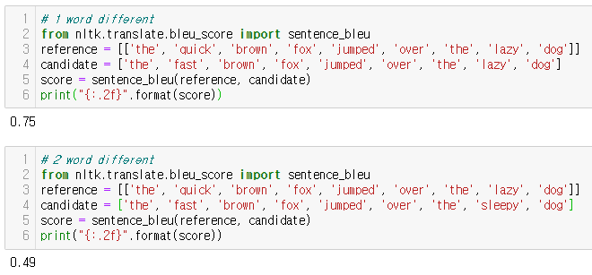
(3/4) Performance Optimization
BLEU score (Bilingual Evaluation Understudy Score)
Evaluation method by N-gram
Moses multi-bleu perl
https://github.com/moses-smt/ mosesdecoder/blob/master/ scripts/generic/multi-bleu.perl
https://machinelearningmastery.com/calculate-bleu-score-for-text-python/
Notes:
BLEU score 는 n-gram 을 이용하며, 카운트에 기반한 통계적 접근 방식이다.
BLEUS score uses n-gram and is a statistical approach based on counts.
확률 점수이므로 0부터 1까지이다.
원문과 정답 문장이 일치할수록 점수가 올라간다.
Since it is a probability score, it is from 0 to 1.
The more the original and correct sentences match, the higher the score.

Slide 49
(4/4) Inference Speed Optimization
Improve translation speed
GPU inference, CPU inference
Lighten Model, On-Device NMT
Decrease Encoder or Decoder Layer of NMT
Decrease model size, increase speed
Decrease model capacity (Algorithm) or change model structure
Decrease or share parameter
※ Often a slight decrease in translation performance (trade-off)
Notes:
딥러닝에서 inference란 학습된 model을 사용해서 입력에 대한 답을 추론하는 것
In deep learning, inference is to infer the answer to the input using a trained model

Slide 50
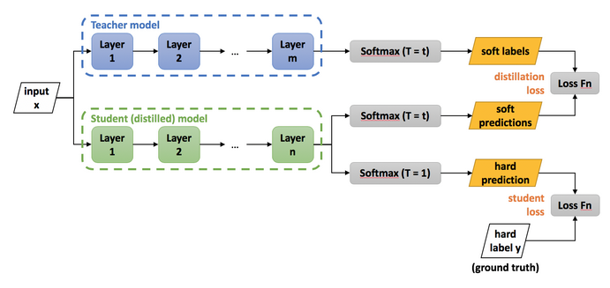
(4/4) Inference Speed Optimization
(Additional) Knowledge Distillation
Transfer pre-trained knowledge (softer softmax) from teacher (big model) to student (small capacity model)
https://light-tree.tistory.com/196
https://intellabs.github.io/distiller/knowledge_distillation.html
http://dmqm.korea.ac.kr/activity/seminar/304
https://blog.lunit.io/2018/03/22/distilling-the-knowledge-in-a-neural-network-nips-2014-workshop/
Notes:
Distillation (증류) 는 불순물이 섞여 있는 혼합물에서 원하는 특정 성분을 분리시키는 방법을 말합니다.
Distillation refers to the separation of a specific desired component from a mixture of impurities.
즉 불필요하게 많은 parameter 가 사용되는 (불순물이 많이 섞인) ensemble model로부터,
generalization 성능을 기존 대비 향상시킬 수 있는 knowledge들을 분리해 내는 방법을 말합니다.
In other words, from the ensemble model where too many unnecessary parameters are used,
separate knowledge that can improve generalization performance compared to previous ones

Slide 51
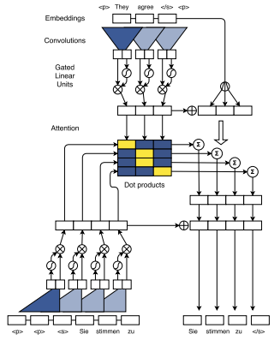
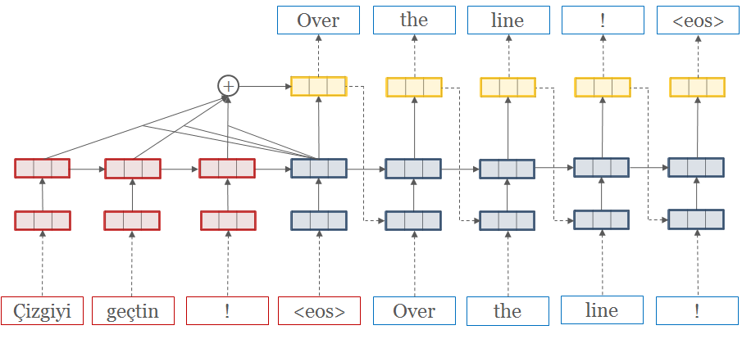
Open Source
OpenNMT
by Havard NLP group & Systran
tensorflow, pytorch
FairSeq (Facebook AI Research Sequence-to-Sequence Toolkit)
FairSeq
by Facebook AI Research
pytorch
Notes:
Recent research uses the following two models the most:
It was developed by ~ and supports tensorflow.

Slide 52
Example
Dataset
Tokenization
Model Train
Evaluation
AI Hub Data
WMT, Europal
...
Mecab, Okt, Moses…
BPE
OpenNMT
FairSeq
Model test
BLUE score
Original (KO) | Reference (EN) | OpenNMT Translation Result
우리는 일주일에 5 일을 학교에 갑니다. | We go to school 5 days a week. | We go to school for 5 days a week.
다음 주말에는 함께 술을 마시기로 해요. | Let's drink together next weekend. | I will drink together next weekend.
난 당신이 행복해지기를 너무나 원해요. | I so want you to be happy. | I really want you to be happy.
Notes:
This is the result of NMT model built according to the process.
The process is complex, but in fact, you can simply build a translation system with a dataset.

Slide 53
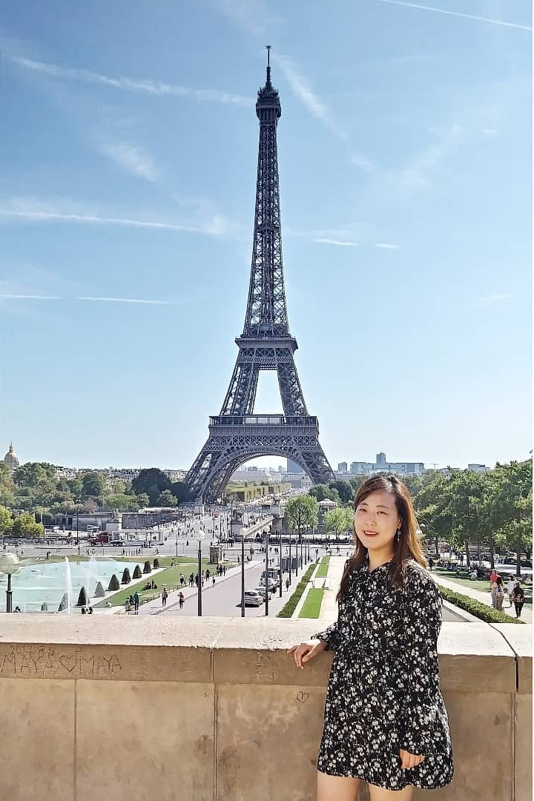
Q & A
https://www.facebook.com/minjoo.choi.562/
https://github.com/Judy-Choi

